Slide 1
Slavery, States’ Rights, and Western Expansion
American History

Slide 2
Goals
Students will be able to:
Review the causes and consequences of the Civil War
Identify the characteristics that define and differentiate regions
Terms to know:
Wilmot Proviso, Free-Soil Party, popular sovereignty, secede, Compromise of 1850, Fugitive Slave Act

Slide 3
Warm-up

Slide 4
Slavery Divides the Nation
Describe the difference between Northern and Southern ways of life prior to the Civil War
North:
South:
These regional difference helped pave the way for the issues in the civil war
One key question that existed with the expansion of the United States is should the United States allow for slavery’s expansion into the west
The Wilmot Proviso asked for slavery and involuntary servitude to be banned in any lands won from Mexico
Southerners strongly opposed the measure and it failed in the Democratically dominated Senate

Slide 5
Fighting to End Slavery
Many political parties were created to fight the expansion of slavery
The Free-Soil Party, a huge supporter of the Wilmot Proviso, pledged to resist the power of slavery and pledged to push for freedom for all
They believed in free soil, free speech, free labor, and free men

Slide 6
Dodging the Issue
Both the Whigs and the Democrats avoided the topic of slavery in order to gain political support in both the North and the South
This was challenged by the rise of the Free-Soil Party
The Dems and Whigs stated that popular sovereignty should rule the issue
This means that the people, not congress, should decide whether slavery should be allowed in the territories

Slide 7
California Causes Issues
With the gold rush 1848 and a rush of lawlessness in California, residents knew it was time for a change
In 1849 residents of California drafted a constitution and asked to be admitted into the Union as a free, nonslave state
This caused widespread controversy as it would put more free states in the Union than slave
In order to resolve this issue Henry Clay offered up a compromise now known as the Compromise of 1850

Slide 8
Compromise
Clay’s Compromise of 1850 called for:
California to be admitted as a free state
New Mexico and Utah would decide the matter of slavery through popular sovereignty
The slave trade would end in Washington D.C.
Texas would give up claims to New Mexico in return for $10 Million
Many southerners felt that too much power would lie in the hands of the North with this plan
Many felt that stronger fugitive slave laws were necessary
Southerners argued that if fugitive slave protections weren’t included in a compromise, the South should be able to secede, or break away, from the Union

Slide 9
Passage
By September 1850, after great struggle, each portion of Clay’s compromise had been passed as individual legislation
A new Fugitive Slave Act added strong amendments to earlier law, including the requirement that private citizens assist with apprehending runaway slaves
Those who aided runaway slaves would be fined or imprisoned

Slide 10
Standards Check
How did the events listed in this presentation lead to the fighting of the Civil War?
Using evidence from this presentation, how did much of the legislation passed prior to the Civil War show the regional differences that existed in the United States?

Slide 11
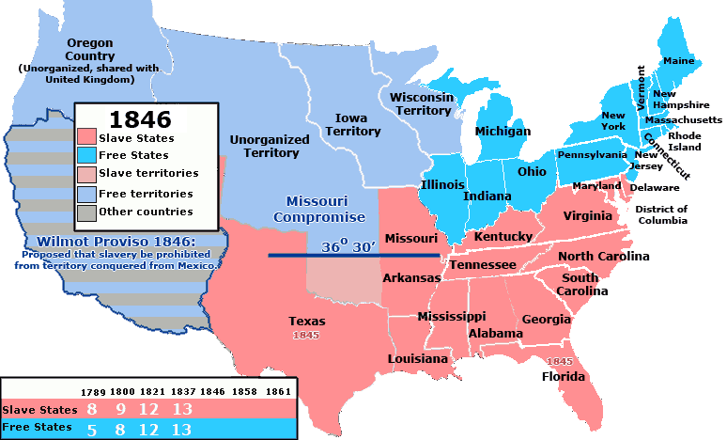

Slide 12
