Slide 1
Resources, Strategies, and Early battles
American History

Slide 2
Goals
Students will be able to:
Review the causes and consequences of the Civil War
Terms to know:
Blockade, Robert E. Lee, Anaconda Plan, border state, Stonewall Jackson, George B. McClellan, Ulysses S. Grant, Shiloh

Slide 4
Advantages
The North:
22 million citizens (compared to the South’s 9 million. 3.5 million of those were slaves)
Control over most of the nations coal and iron
Mechanized factories that could created ammunition, arms, uniforms, medical supplies and railroad cars
A well organized navy
The south had no navy, and was left vulnerable to blockades

Slide 5
Advantages
The South:
The feeling amongst Northern citizens who felt the South should be aloud to leave
Strong military leaders, such as Virginia's Robert E. Lee
Lee was offered command of the Union army, but declined not wanting to raise arms against his family and neighbors
The ability to fight a defensive war

Slide 6
Strategy
The Confederacy hoped to gain foreign recognition
If they were recognized by Europe, it would position them to receive aid to counteract many of the North’s advantages
The Union implemented the Anaconda Plan
This required Union control of the Mississippi river and a successful blockade of Southern ports
Lincoln also aided the Union by avoiding the topic of slavery
This was done to avoid giving the border states of Missouri, Kentucky, Delaware and Maryland reason to secede from the Union

Slide 7
Standards Check:
Using evidence from this presentation, describe how differences between the North and South impacted the fighting of the Civil War.

Slide 8
Bull Run and Union Confidence
The first major battle of the Civil War was the First Battle of Bull Run (aka First Battle of Manassas) in July of 1861
Many from the North felt that this battle would lead to a swift Union victory and that the war would be ended quickly
The Confederacy, lead by General Thomas J. Jackson (Stonewall), was able to put up a strong defense and crush the Union advance
The loss in this battle lead to a leadership change in the Union Army, pushing George B. McClellan into the main leadership role.

Slide 9
Shiloh and New Orleans
In February of 1862, Ulysses S. Grant lead a portion of the Union Army into the Mississippi Valley while trying to execute his portion of the Anaconda plan
The first portion of this campaign was successful and pushed a bulk of the Confederate troops out of Western Kentucky and Tennessee
This success was unfortunately followed by the Battle of Shiloh, where 25,000 troops were killed or wounded
This loss of fighters was a great blow to the Union and the Confederacy, and greatly damaged Grant’s reputation
The Battle of Shiloh did however lead to Union success as it allowed David Farragut to lead the Union Navy in the capture of New Orleans
Both Grant and Farragut tried to lead a two front capture of Vicksburg, but both were pushed back by the Confederates

Slide 10
Monitor v Virginia
One of the few major naval battles of the Civil War took place in 1862 between two ironclads known as the Monitor and the Virginia
Both ships exchanged fire in multiple rounds, and neither ship was able to sink the other
While there wasn’t a major strategical impact of this battle, it was a symbol of how naval warfare would be changing in the future, as wooden ships would quickly become a symbol of the past

Slide 11
Standards Check:
Using evidence from this presentation, describe how the Civil War impacted Union and Confederal leaders.

Slide 12
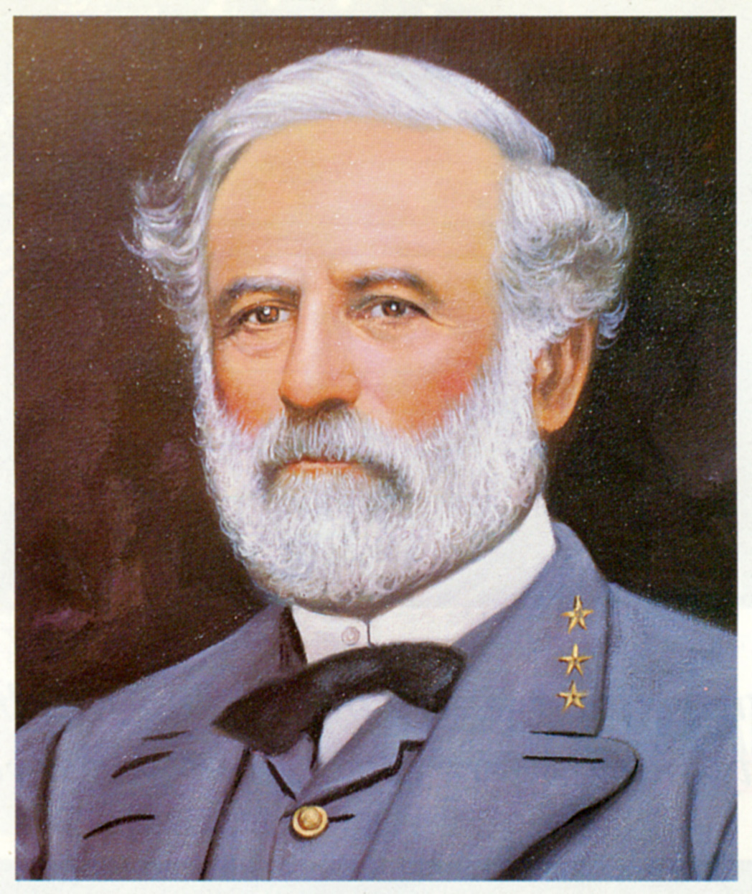

Slide 13
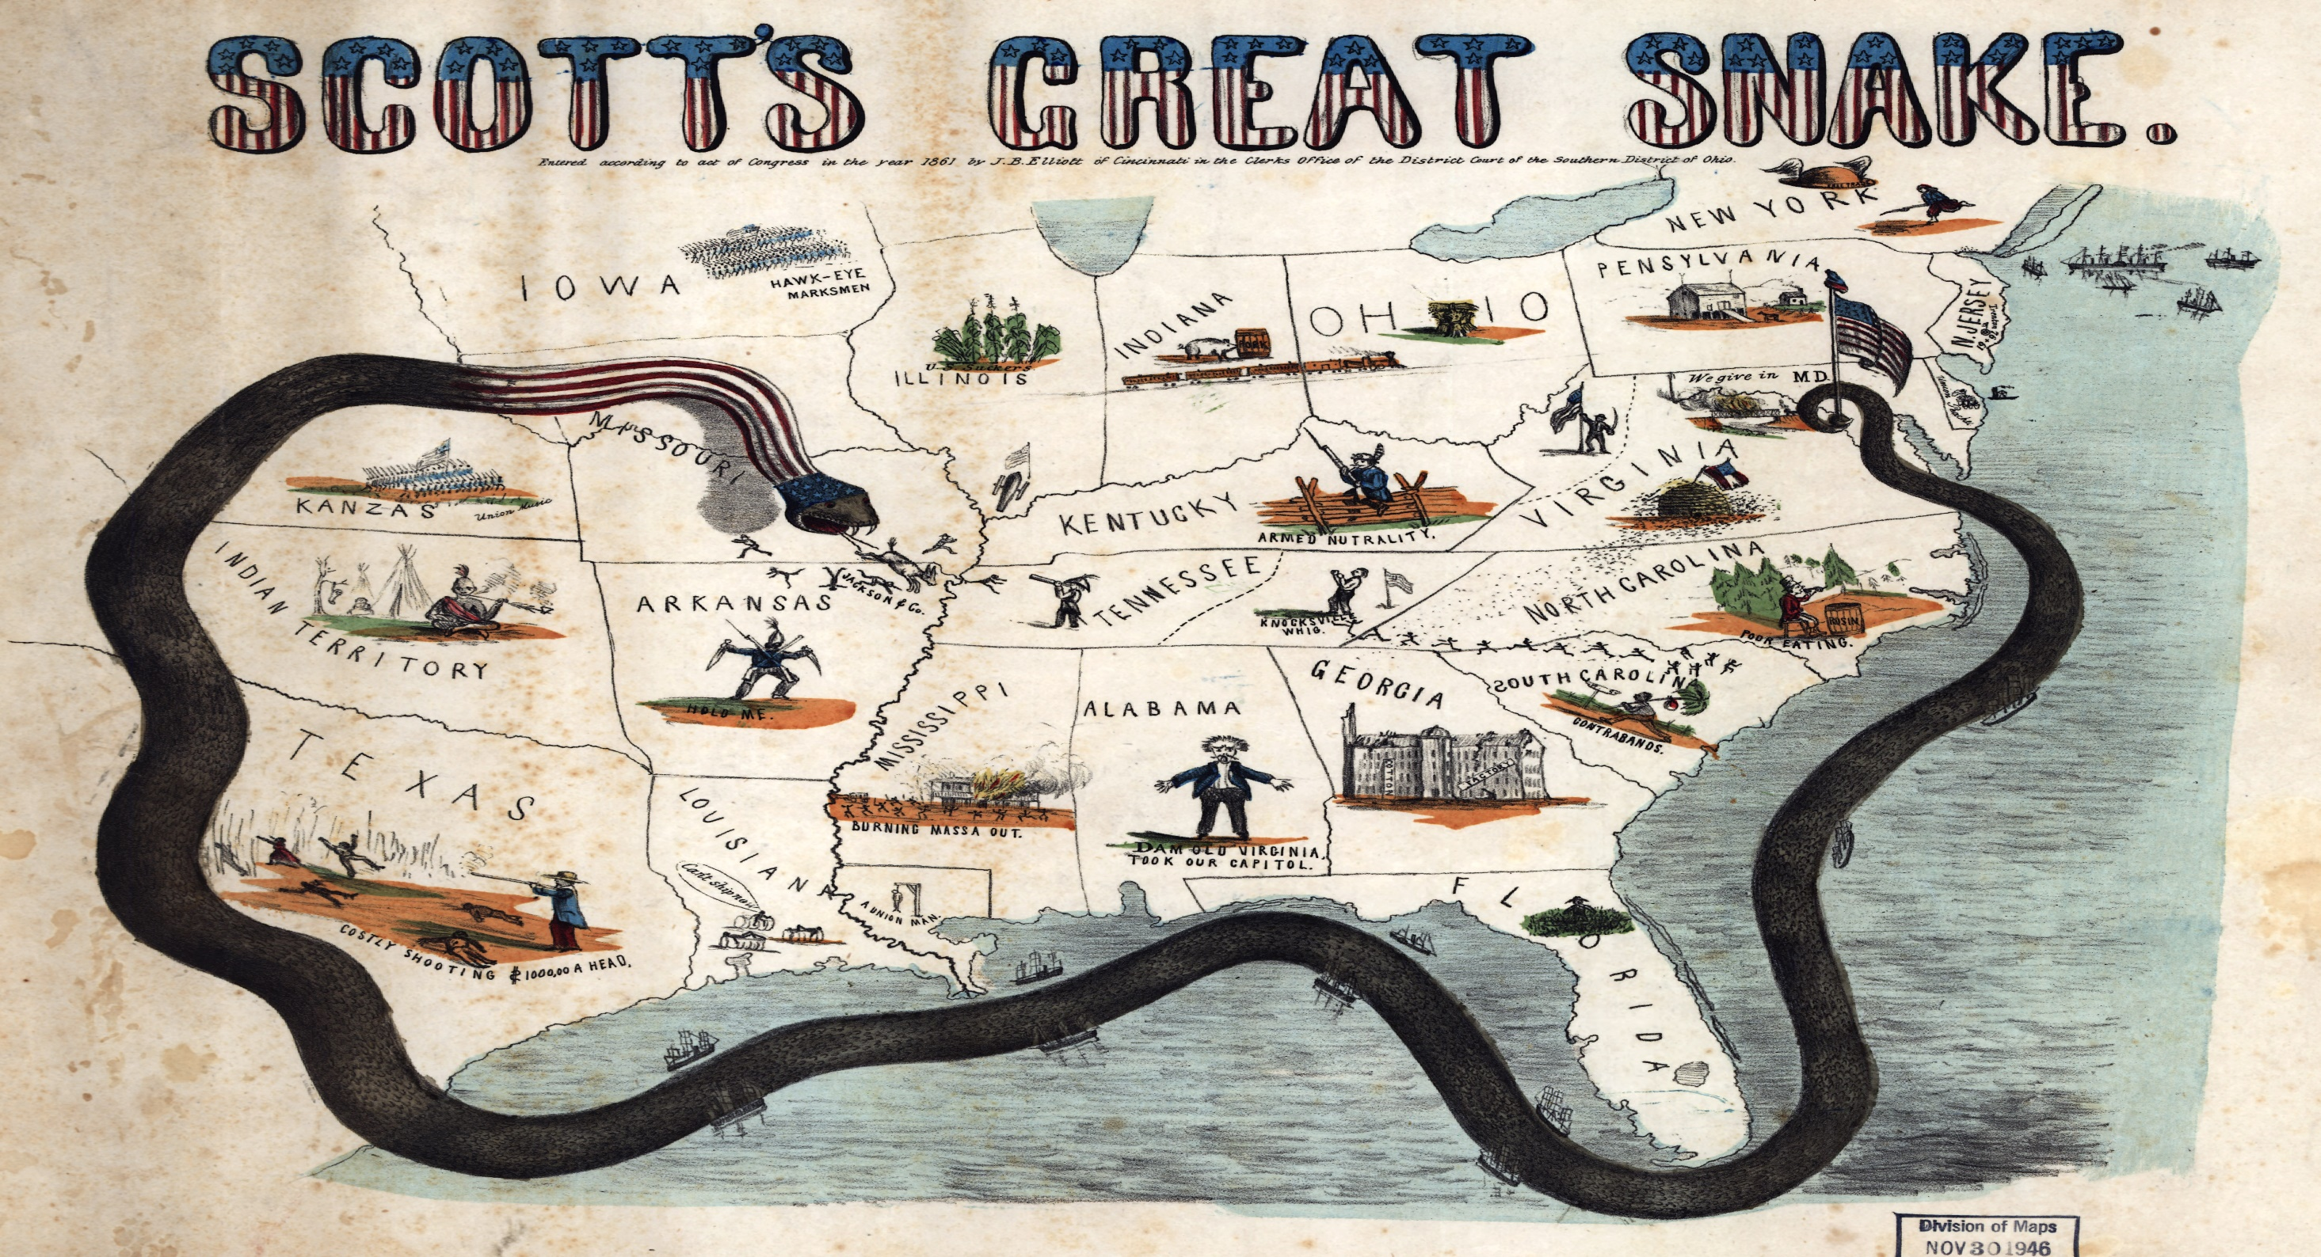

Slide 14
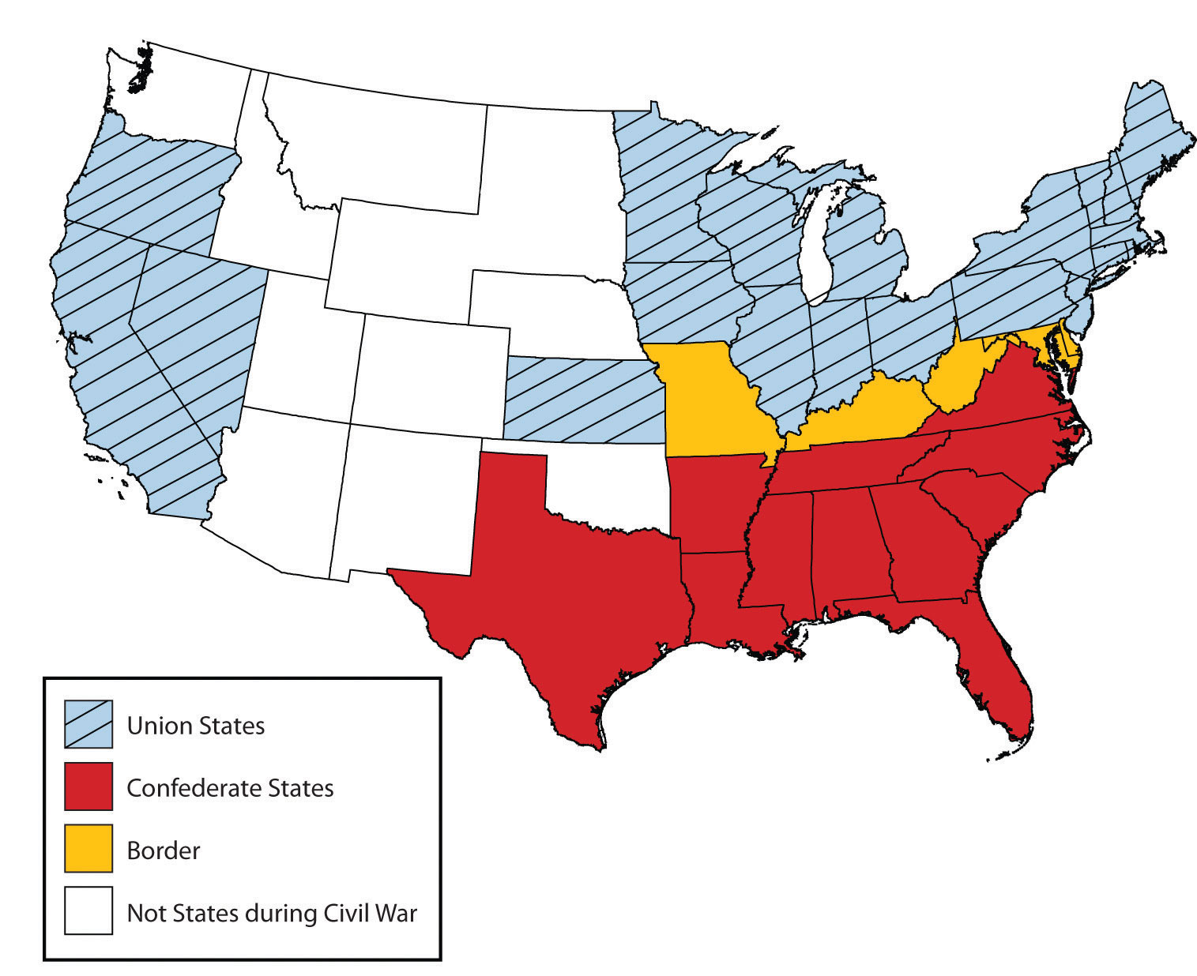

Slide 16
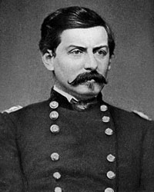

Slide 17
