Slide 1
A Rising Tide of Protest
American History

Slide 2
Goals
Students will be able to:
Analyze how images may be used to interpret the past
Review the causes and consequences of the Civil War
Identify the characteristics that define and differentiate regions
Terms to Know:
Personal liberty laws, Underground Railroad, Harriet Tubman, Harriet Beecher Stowe, Kansas-Nebraska Act, John Brown, “Bleeding Kansas”

Slide 3
Resistance Against the Fugitive Slave Act
One of the main points of contention with the Compromise of 1850 was the stringent Fugitive Slave Act
Those who opposed this act were angered by the requirement of citizens to catch and return runaway slaves
This also resulted in free blacks sometimes being captured and sold into slavery (Like the movie 12 Years a Slave)
In response to this anger, some northern states passed personal liberty laws
These personal liberty laws nullified the Fugitive Slave Act and allowed states to arrest slave catchers

Slide 4
Underground Railroad
Northern abolitionists, freed blacks, and even run away slaves helped organize a route to northern freedom known as the Underground Railroad
This Underground Railroad was comprised of a network of farm wagons, riverboats, homes, and barns that helped run away slaves hide from slave hunters.
This network used complex signals and hiding places and directions were often carried through songs that slaves would sing on the plantation
Harriet Tubman was one of the most successful “conductors” of the Underground Railroad
Known as “Black Moses”, Tubman made about two dozen trips back into the south, risking her life as a run away slave, to bring more blacks to freedom

Slide 5
Condemnation Slavery
One of the most popular critiques of slavery was published in 1852 by Harriet Beecher Stowe
The book Uncle Tom’s Cabin detailed what it was like to live in slavery and provided many people with the spark needed to start opposing slavery through various abolitionist movements
The book sold over 300,000 copies in it’s first year and lead to greater differences between the North and the South

Slide 6
Kansas-Nebraska
After the failed compromises such as the Missouri Compromise, the Wilmot Proviso and the Compromise of 1850, many still supported the idea that the spread of slavery should be resolved by popular sovereignty
The south fought hard against the concept of popular sovereignty and worked to expand slavery into western territories
After much debate, the Kansas-Nebraska Act was passed
The act split the Nebraska territory into two and was supposed to allow Kansas to become a slave state and Nebraska to organize as a free state
This act nullified the Missouri Compromise and allowed slavery to spread to area’s that had previously been free, thus causing further tension between Northern and Southern states

Slide 7
A Tale of Two Governments
In order to try and secure each regions interests, both Northerners and Southerners poured into Nebraska trying to outnumber each other and then control the government
As the conflict grew more heated both pro and anti slavery proponents set up their own individual governments and began to pass laws regarding slavery through Kansas
Both governments than tried to petition for statehood, pushing their own idea of whether or not slavery would continue to exist in Kansas’s future

Slide 8
Violence
The high tensions between pro and anti slavery camps eventually boiled into violence
John Brown, a major New York abolitionist, led a raid and execution of proslavery settlers
This led to further violence between the pro and anti slavery movements
Due to the violence that erupted in 1856, the territory became known as “Bleeding Kansas” because of all of the bloodshed that occurred over the issue of slavery and state control

Slide 9
Senate
The debate over the spread of slavery into the west became so intense that even politicians became violent with each other
During a heated debate Charles Sumner insulted the actions of those trying to institute slavery in Kansas and personally insulted South Carolina Senator Andrew Butler
A few day’s later Butler’s nephew, a representative from South Carolina, beat Charles Sumner almost to death with his cane as punishment for his harsh words

Slide 10
Standards Check
Using evidence from this presentation, how did the events in Kansas show the issues that stemmed from the regional differences that existed in the United States prior to the Civil War?
Using evidence from this presentation, how did the response to slavery show both regional differences in the United States and causes of the Civil War?

Slide 11
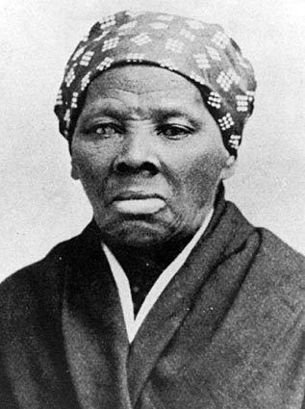

Slide 12
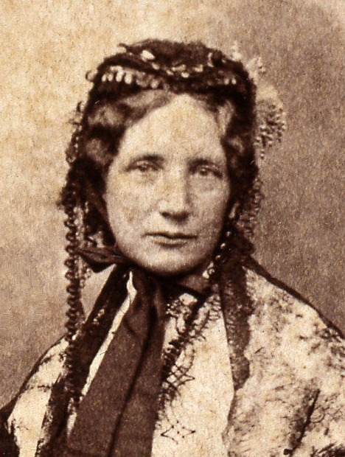

Slide 13
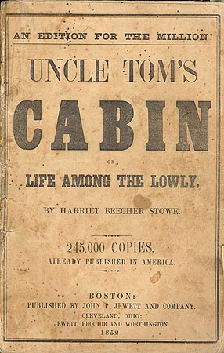

Slide 14
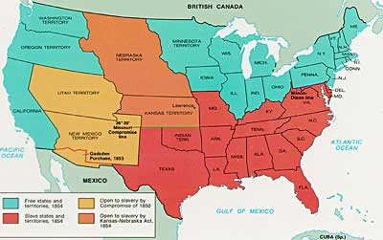

Slide 15
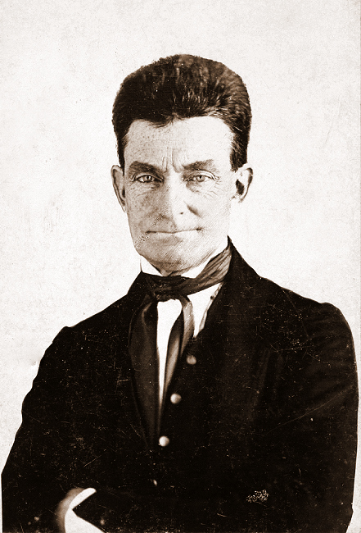

Slide 16
