Slide 1
African Americans and the War
American History

Slide 2
Goals
Students will be able to:
Review the causes and consequences of the Civil War
Terms to Know:
Contraband, Antietam, Emancipation Proclamation, Militia Act, 54th Massachusetts Regiment

Slide 3
Warm-up:

Slide 4
The Push Toward Emancipation
Early in Lincoln’s presidency there was a strong push by abolitionists such as Frederick Douglas and William Lloyd Garrison to end slavery
This was despite Lincoln’s early attempts to downplay the issue slavery
It was because of the desire to gain support for ending the war that Lincoln finally started to push for the end of slavery.
The concept of slavery was very unpopular in Europe at the time and it was this anti-slavery sentiment that prevented England from aiding the Confederacy

Slide 5
Issues with Slaves
Those slaves who were taken by the Union army during the war were at times labeled as contraband, or captured war supplies
This allowed the Union army to refuse to return slaves to their previous owners
General John Fremont had started declaring captured slaves in Missouri free
But because of fear that the border states would turn on the Union, Lincoln reversed this decision

Slide 6
Emancipation
Prior to the Battle of Antietam, Lincoln had started drafting an announcement that would free all slaves in the rebel states
During the Battle of Antietam, Lee led his troops into Maryland in hopes of finding supplies
After finding plans for the battle, Union troops met Confederate troops in the city of Sharpsburg. This battle ended up being the single most bloody battle in the war, leaving 23,000 soldiers dead or wounded
It was after the Union victory at Antietam that provided Lincoln with the appropriate springboard to deliver the emancipation proclamation
The proclamation freed all of the slaves in the rebel states, strategically ignoring the slaves in the border states therefore ensuring further support from those states

Slide 7
African American’s Join the Fight
After the Emancipation Proclamation, the Union allowed black troops to be recruited into the military. This was facilitated by the militia act which mandated that black troops be allowed to serve in the military
With this units such as the 54th Massachusetts Regiment were created
This all black unit consisted of more than 180,000 African American soldiers
Most of these troops spent the early part of their military career doing menial labor jobs that kept them out of battle
Black troops were able to shine in battles such as the Battle of Port Hudson and the Battle of Fort Wagner
In these battles African American troops were able to show their worthiness to help in the push to win the Civil War
Many slaves had been abandoned allowing them to help the Northern armies in finding and growing food, scouting local areas, and it also allowed them to demand wages for their work or to flee to free parts of the country

Slide 8
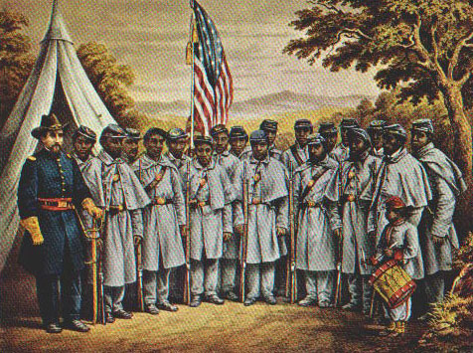

Slide 9
Standards Check
Using evidence from the presentation, describe the consequences for the south regarding slavery.
Using evidence from the presentation, describe the impact of African American’s on the Union war effort.

