Slide 1
Life During the War
American History

Slide 2
Goals
Students will be able to:
Analyze how images may be used to interpret the past
Review the causes and consequences of the Civil War
Terms to Know:
Income Tax, bond, Homestead Act, Conscription, Copperhead, Habeas Corpus, Inflation, Clara Barton

Slide 3
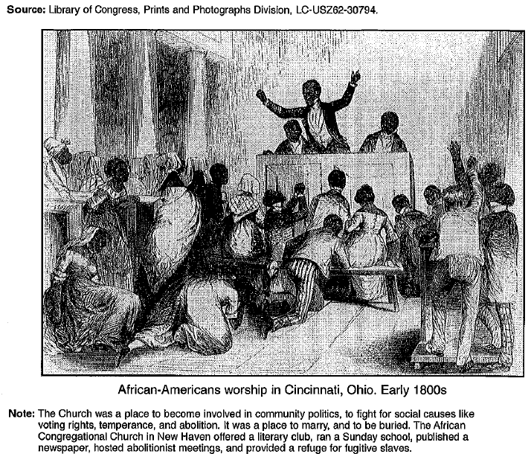
Warm-up

Slide 4
Economic Changes
The Civil War had a major impact on the Northern economy
Demands for goods such as clothing, arms, and other war supplies dramatically rose
This led to the greater mechanization of industry, allowing for factories to meet the needs of demand
Another economic impact of the Civil War revolved around taxes
Anyone who earned an income over $800 a year paid a 3 percent income tax
Because of the rising price of war, the tax continued to increase throughout the war
The Union also raised tariffs to bring in extra revenue

Slide 5
Economic Changes
A huge source of wartime income came from the selling of government bonds
Bonds allow you to purchase a certificate for a certain amount of money, and the seller promises to pay the holder of the bond more money at a future date

Slide 6
Standards Check
How did the Civil War change the economy?

Slide 7
Land grants
In 1862, the United States Congress passed the Homestead Act
This made land in the west available at low costs to those who promised to farm it
These lands were granted off of proposed rail lines that would eventually make up the transcontinental railroad

Slide 8
Drafts and Liberties
One major issues that erupted during the civil war dealt with the concept of conscription
Conscription is a draft that requires individuals to participate in military service
The draft took men between ages 20 and 45. You could avoid conscription by paying $300, but the average salary of the time was just $2 a day
the draft largely fell on the poor and recent immigrants and led to the Draft Riot of July 1863 where many factories were damaged
Rioters were not the only one’s who challenged the Union’s take on the war
Copperheads, also known as “peace democrats”, participated in demonstrations, and sometimes violence, to try and end the war
Lincoln dealt with these individuals by suspending their right to habeas corpus and arrested people suspected of disloyalty to the Union
Habeas corpus is the right of and individual to avoid being arrested and held in jail without being charged with a specific crime an

Slide 9
Southern Issues
One of the biggest issues that the south had to deal with was the Union blockade on southern ports
By 1863, the Union blockade was able to prevent 80% of ships from making it to southern ports
This resulted in the south to almost solely depend upon what they could produce in their own farms and factories

Slide 10
Paying for the War
Much of the wealth that southern planters possessed was not liquid
Southern planters had 3 million slaves and their property, but very little other currency
To do with their mounting economic issues, Confederate troops had to scrounge for food and supplies
This often meant stealing Union weapons, food and supplies when possible
The south also had issues with collecting taxes and import duties as many refused to pay
The Confederate money also lacked value, and because of the number of bills printed and the lack of a physical gold or silver backing the value of their money, inflation ran rampant

Slide 11
A Soldiers Life
About 50% of Northern men of fighting age and about 80% of Southern men of fighting age took part in the civil war
Soldiers often had to deal with the boredom of travel and homesickness while also having to deal with the fear of death, poor drinking water
New weapons caused severe wounds that maimed many individuals
The most frequent course of treatment was amputation
Despite the dangers of injury, infection was the main danger
For every soldier killed in battle, two died of disease
POW camps were also in horrendous conditions, especially in the south
Because Southern troops were already having a hard time finding food for themselves, they had little incentive to find food for their prisoners
This lead to thousands of POWs dying of malnutrition and disease

Slide 12
Women and the War
Many women were able to take over family business, farms, and plantations while their husbands and sons went off to war
Women were also able to help in military camps as nurses and house keepers
Clara Barton pushed to collect medical supplies to personally help wounded soldiers in battle
Clara Barton went on to help wounded soldiers In many European Battles
She was eventually responsible for the creation of the Red Cross, an organization dedicated to helping people survive and rebuild after disastrous events

Slide 13
Standards Check
How did the Civil War impact the lives of civilians and of soldiers?
What role did women play in the events of the Civil War?

