Slide 1
Political Realignment Deepens the Crisis
American History

Slide 2
Goals
Students will be able to:
Utilize primary and secondary sources to understand a historical period
Review the causes and consequences of the Civil War
Identify the characteristics that define and differentiate regions
Terms to Know:
Know-Nothings, Republican Party, Dred Scott, Roger B. Taney, Dred Scott v. Sanford, Abraham Lincoln, Stephen A. Douglas, Harpers Ferry

Slide 3
Warm-up

Slide 4
Changes in Politics
In early American politics, it was not easy to distinguish political party based upon the region one came from
This begins to change in the 1840’s as the issue of slavery became more divisive
During this time of change the Whig party supported California’s entry into the U.S. as a free state
The party also had issues with the Compromise of 1850
This lead to the end of the Whig Party in the U.S.
Another party known as the “Know-Nothings” also lost power during this time period
This group generally held extreme nativist attitudes, which they would publically deny
By 1855 the Know-Nothings stopped being secretive about their nativist viewpoints in order to form as a political party
The party soon dissolved because of differences on the opinions of slavery across it’s members

Slide 5
The Republican Party
As parties began to disappear, new parties needed to be created to fill the void
The Republican party was one of those parties and was formed in 1854
Opposition to slavery was the key philosophy of the Republicans
The party was able to attract members of all other parties who held the same anti-slavery sentiments and was also able to attract many businessmen to their side as well
In 1856 the Republican party began to take the national stage

Slide 6
Sectional Differences
The election of 1856 put Republican John. C. Fremont against Democrat James Buchanan and Known-Nothing Millard Fillmore (former President from Whig party 1850-1853)
Buchanan was able to win by gaining southern support after stating that he would end “the agitation of the slavery issue”
This put even more strain between the North and the South

Slide 7
Standard Check
How did the change in political parties illustrate the differences between different regions in the United States?

Slide 8
Dred Scott
The Dred Scott v. Sanford case revolved around a slave who had been taken into Missouri to the free state of Illinois and the Wisconsin Territory
Once in this free land, Dred Scott sued his master for his freedom, stating that since he was in a free state, he should be legally allowed to retain his freedom
Chief Justice Roger B. Taney and the Supreme court ruled against Dred Scott
The ruling stated that not only could slaves not sue because they were property, but that no black could sue because they were not considered citizens even if free

Slide 9
Lincoln-Douglas Debates
In 1858, Stephen Douglas and Abraham Lincoln held a series of debates while campaigning for a seat in the U.S. Senate
In these debates Douglas and Lincoln took on contrasting viewpoints regarding the expansion of slavery
Douglas believed that the expansion of slavery should be handled through the process of popular sovereignty
Lincoln took an opposing view and stated that popular sovereignty was wrong and that the system of slavery was unjust
Douglas was able to win the Senate election, but Lincoln had gained many supporters which would eventually aid him in winning the presidency in 1860

Slide 10
John Brown’s Raid
Prior to his capture, Brown led many anti-slavery revolts throughout Kansas.
In 1859 Brown set out to seize the federal arsenal in Harpers Ferry, Virginia
Brown had hoped that this seizure would inspire slaves to revolt against their masters
Brown’s actions failed to inspire much real support as he was looked at to radical even by most abolitionists
Brown was surrounded at the arsenal, was arrested, and then was latter executed by hanging
The events of John Brown’s raid of Harpers Ferry led to greater divisions between the North and South

Slide 11
Standard Check
Using information from this presentation, how did these events lead to the fighting of the Civil War?

Slide 12
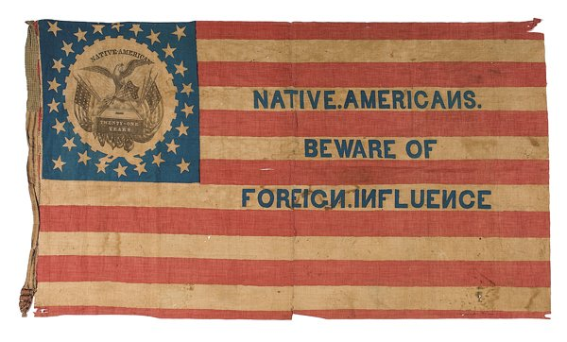

Slide 13
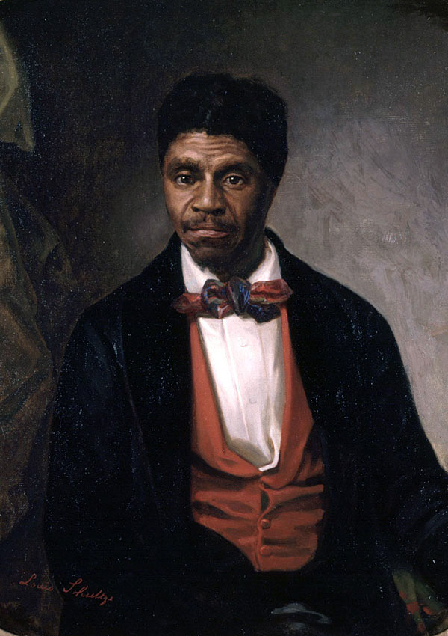

Slide 14
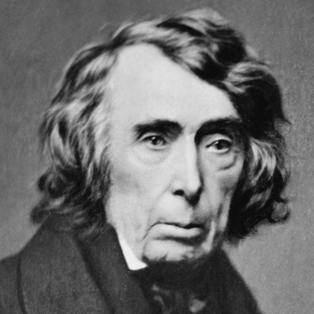

Slide 15
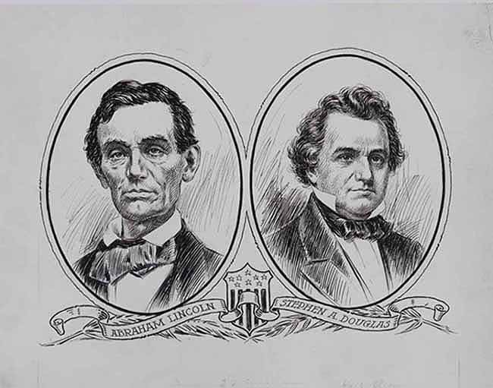

Slide 16
