Slide 1
Lincoln, Secession, and War
American History

Slide 2
Goals
Students will be able to:
Review the causes and consequences of the Civil War
Identify the characteristics that define and differentiate regions
Terms to Know:
Jefferson Davis, John C. Breckinridge, Election of 1860, Confederate States of America, Crittenden Compromise, Fort Sumter

Slide 3
Support
In 1860, Jefferson Davis of Mississippi convinced Congress to adopt resolutions restricting federal control of slavery in the territories
These resolutions also prohibited Congress, or any state, from interfering with slavery where it already existed

Slide 4
Election of 1860
Three main candidates sought the presidency in 1860
The Democrats supported two different candidates
The North supported Stephen Douglas. Douglas thought popular sovereignty should decide the issue of slavery.
The South supported John Breckinridge. Breckinridge wanted to expand slavery into the territories
The Republicans supported one candidate by the name of Abraham Lincoln
Lincoln felt that slavery should not be allowed into the territories
Lincoln won the election of 1860 despite not carrying a single southern state (he was not even on the ballot in many southern states)

Slide 5
Standard Check
How does the split in democratic party show the difference between the north and south’s view on slavery?

Slide 6
Collapse
On December 20th, 1860 South Carolina held a convention to decide the fate of their union with the United States
In a unanimous decision, it was decided that South Carolina would secede from the Union
Over the next few weeks six more southern states would secede
Not all seceded with as much unity as South Carolina displayed

Slide 7
Confederacy
In February of 1861, the Confederate States of America was established
The constitution passed by the CSA explicitly outlined their rights and their ability to secede if desired
It also guaranteed the right of slavery
In order to try and stem war, John Crittenden proposed a new constitutional amendment
This amendment was to allow slavery in western territories and federal reimbursement for runaway slaves
The Crittenden Compromise was narrowly voted down.

Slide 8
War Begins
When Lincoln took office on March 4th, 1861 Lincoln stated the following:
He had no purpose, directly or indirectly, to interfere with the institution of slavery
That he intended to preserve the Union
No state, upon its own mere action, can lawfully get out of the Union
He would not fight a war, unless the South started it

Slide 9
War Begins
When the south seceded from the Union, all but four forts were lost to the south
Union troops were unable to receive supplies from the North because of Southern blockades
Eventually, the South demanded that Northern troops vacate Fort Sumter
When they refused, the south fired upon the fort, eventually forcing northern troops to surrender
This was the start of a long, bloody conflict

Slide 10
Standards Check
If you had to tell an alien, with one word, what caused the Civil War, what would you say?

Slide 11
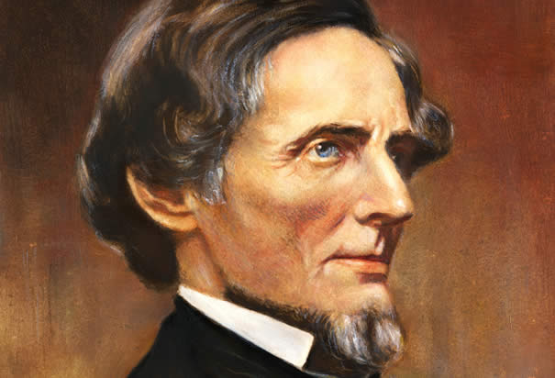

Slide 12
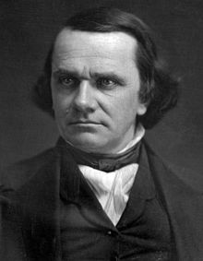

Slide 13
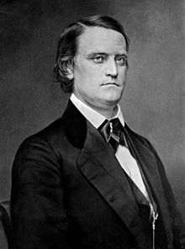

Slide 15
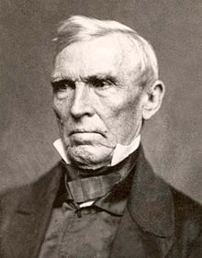

Slide 16
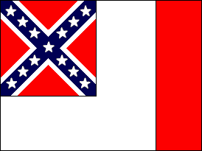

Slide 17
