Slide 1
Turning Points of the War
American History

Slide 2
Goals
Students will be able to:
Review the causes and consequences of the Civil War
Distinguish the freedoms guaranteed in the 13th,14th, and 15th amendments
Terms to know:
Siege, Vicksburg, Gettysburg, George Pickett, Gettysburg Address, total war, William Tecumseh Sherman

Slide 3
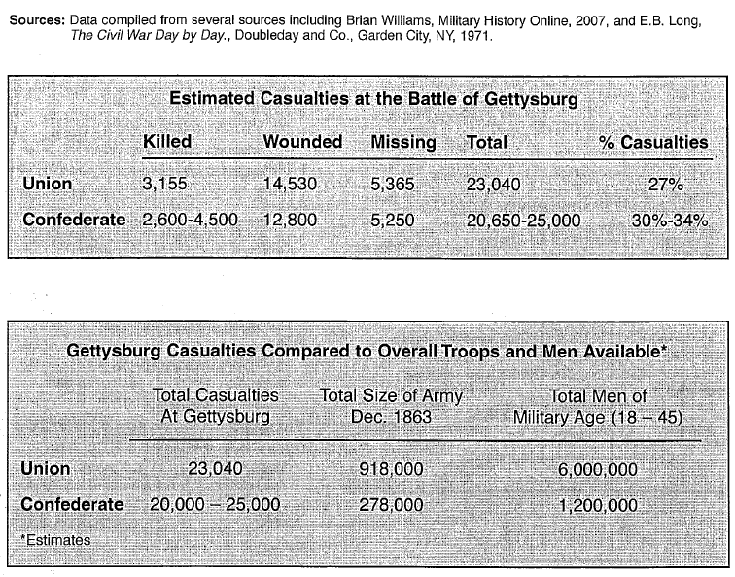
Warm-up

Slide 4
Vicksburg
It was determined that in order for the Anaconda Plan to be successful, Vicksburg, Mississippi, had to be taken from the Confederacy
After multiple failed attacks throughout 1862, General Ulysses S. Grant placed Vicksburg under siege in the spring of 1863
A siege is a military tactic in which an army surrounds, bombards, and cuts of all supplies to an enemy position in order to force surrender.
The siege, which started on May 22nd, ended with the surrender of Confederate troops
This effectively split the confederacy into two parts, weakening its ability to wage war

Slide 5
Lee’s Victories
Despite Union success in the West, The Confederacy’s General Lee was able to deal to heavy blows to the Union
Despite being outnumbered 120,000 to 80,000, Le was able to defeat the Union Army at Fredericksburg
Lee was able to inflict twice as many Union casualties as Confederate Casualties
Lee was also able to defeat the Union army at Chancellorsville
Unfortunately for the South, their great General Stonewall Jackson fell in battle due to friendly fire

Slide 6
Gettysburg
The Battle of Gettysburg took place in Gettysburg, Pennsylvania
Confederate troops were descending on the town to take shoes from a factory in town
Union Troops were initially pushed back and later established a 2.5 mile defensive line
On the second day of battle, Union troops were able to take advantage of a undefended position on Little Round Top
After running out of ammo, Union troops lead a bayonet charge pushing the Confederates back

Slide 7
Gettysburg
On the third day of battle General Lee bombarded the Union lines with artillery
The Confederates then marched across an open field hoping to take the Union line were assaulted by rifle and cannon fire
This charge spelled defeat for the Confederate army
50,000 were dead and wounded as a result of the battle
This loss ended Lee’s invasion of the North

Slide 8
Union Advantage
After Gettysburg, Ulysses S. Grant was put in charge of the entire Union army
Grant pursued Lee throughout the south, trying to inflict damage that he thought the south would not be able to survive
Grant used a strategy of total war, a strategy that involves striking civilian as well as military targets
The use of total war was also used by General William Tecumseh Sherman
In May of 1864 he set out from the Tennessee-Georgia Border with 60,000 troops
He marched 250 miles to capture the port of Savannah
His men looted and destroyed anything of value
The path was 60 miles wide where buildings, railroad tracks, and homes were all destroyed

Slide 9
The War Ends
Weeks after the siege of Petersburg, where the Confederate army was largely destroyed, Grant and Lee meet at Appomattox Court House
It is here where Lee formally surrenders to Grant on April 9th, 1865
Even with this surrender it still took until June of 1865 for the Civil war to officially end

